Slide 1
Celebrity image classifier
.

Slide 2
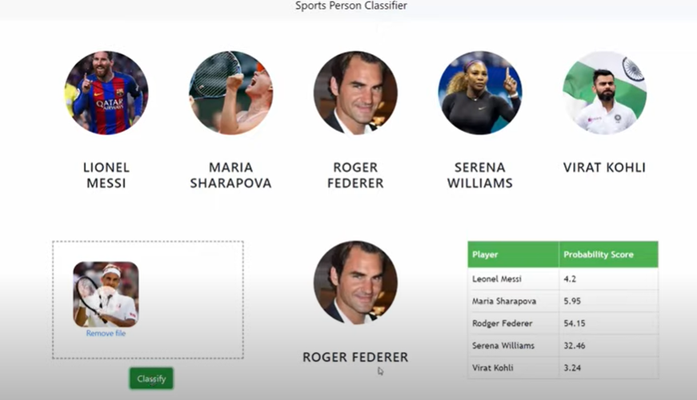
Agenda
Our main goal is to build a website in which you can drag and drop an image of sports person and it will tell you which sports person that is.
We are restricting our image classification to only five classes

Slide 3
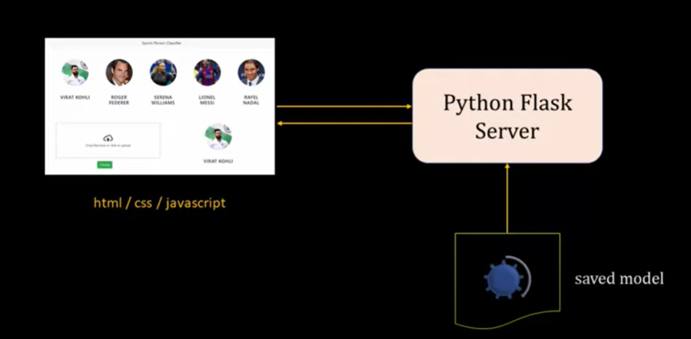
Project outline

Slide 4

Data collection
Web scrapping
Chrome extension
3rd party vendors

Slide 5
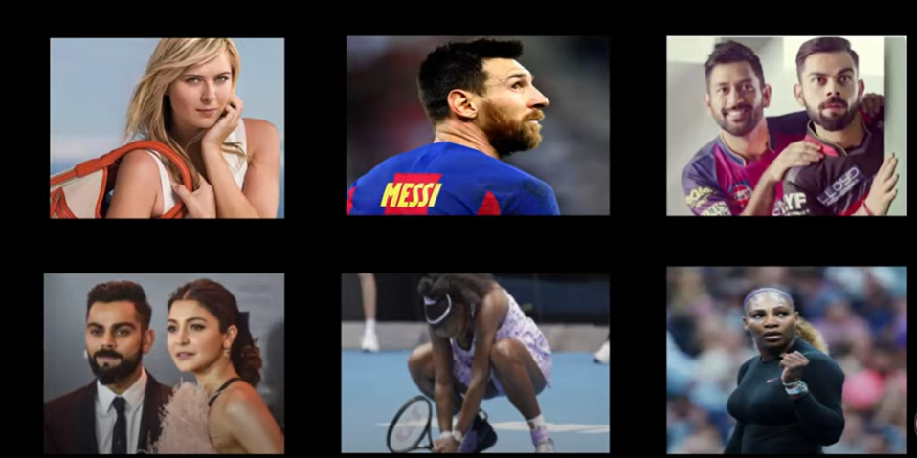
Data cleaning

Slide 6
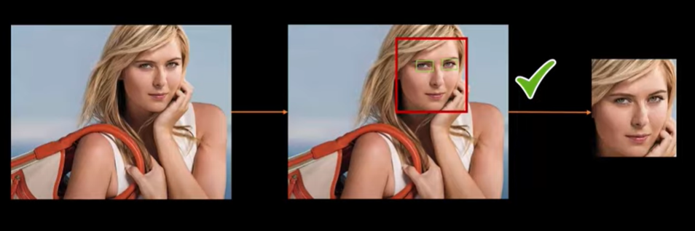
Data cleaning

Slide 7
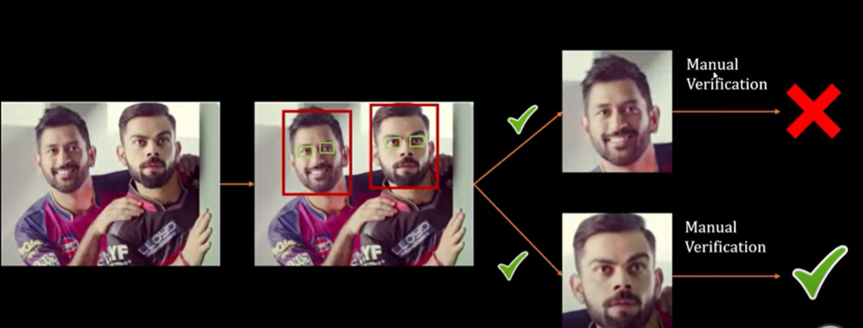
Data cleaning

Slide 8
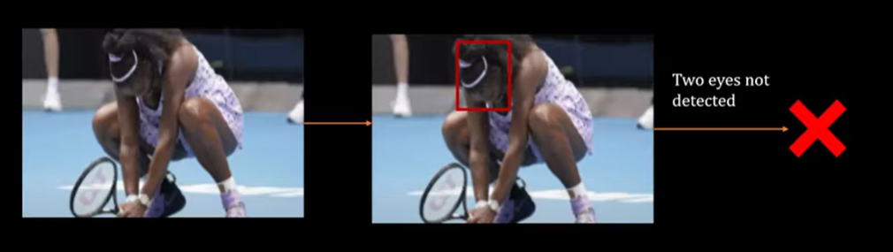
Data cleaning

Slide 9
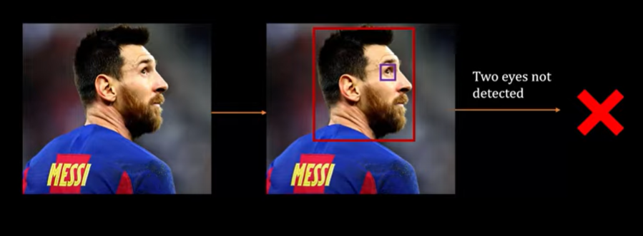
Data cleaning

Slide 10
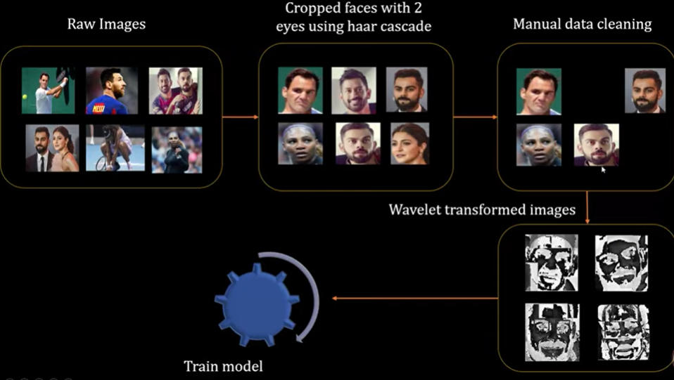
Data cleaning process

Slide 11
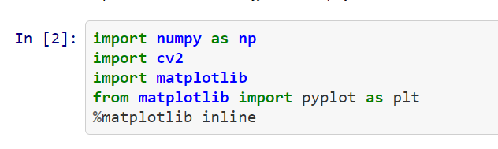
Import libraries

Slide 12
Data Preprocessing
When we look at any image, most of the time we identify a person using a face. An image might contain multiple faces, also the face can be obstructed and not clear. The first step in our pre-processing pipeline is to detect faces from an image. Once face is detected, we will detect eyes, if two eyes are detected then only we keep that image otherwise discard it.

Slide 13
How can we detect face and eyes
We will use haar cascade from opencv for this.
Article for haar cascade
https://opencv-python-tutroals.readthedocs.io/en/latest/py_tutorials/py_objdetect/py_face_detection/py_face_detection.html?highlight=haar

Slide 14
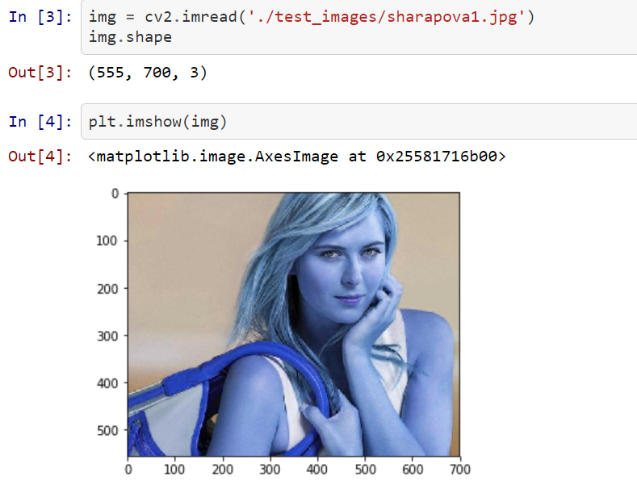
Reading an image from openCV

Slide 15
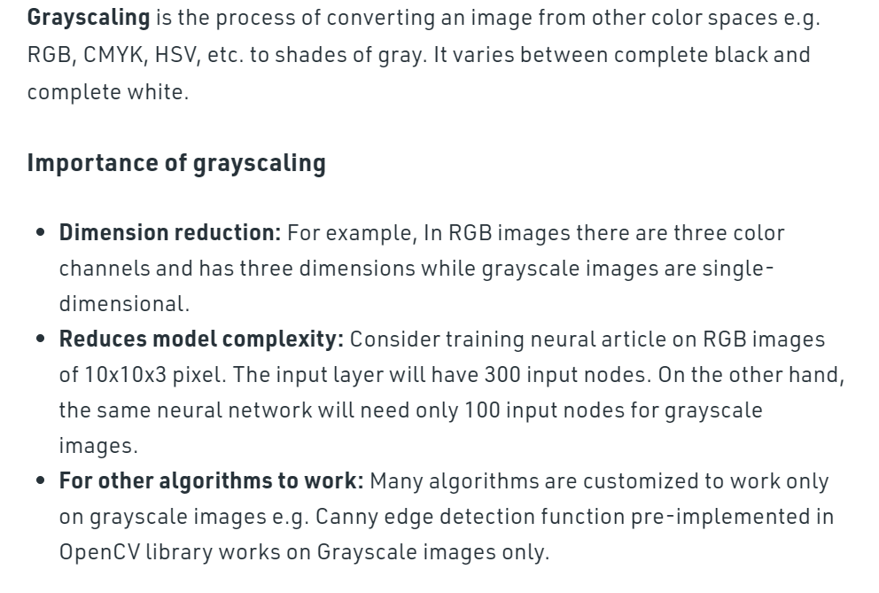
Grayscaling of an image using openCV

Slide 16
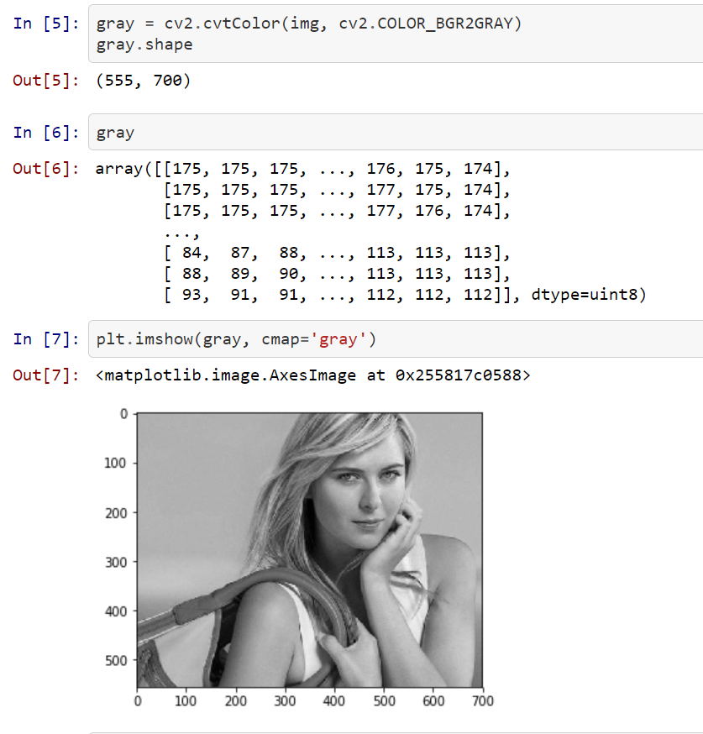
Reading a gray image

Slide 17
Face detection using HAAR cascade classifiers
It is an Object Detection Algorithm used to identify faces in an image or a real time video. The algorithm uses edge or line detection features proposed by Viola and Jones in their research paper “Rapid Object Detection using a Boosted Cascade of Simple Features” published in 2001. The algorithm is given a lot of positive images consisting of faces, and a lot of negative images not consisting of any face to train on them.

Slide 18
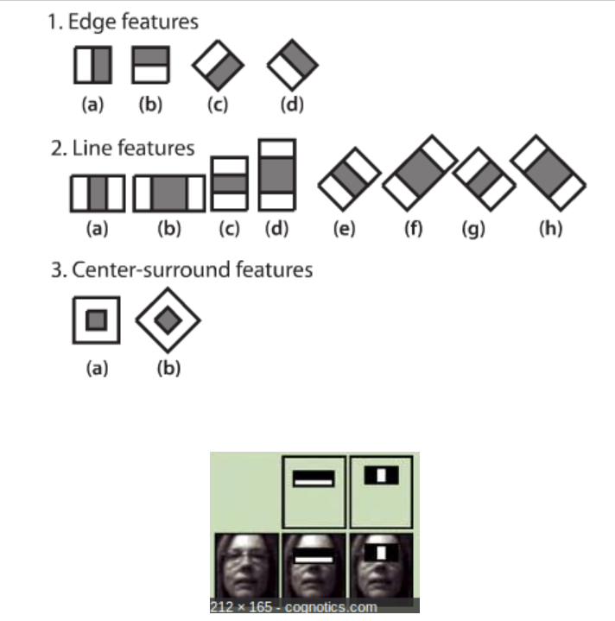
HAAR Cascade features

Slide 19
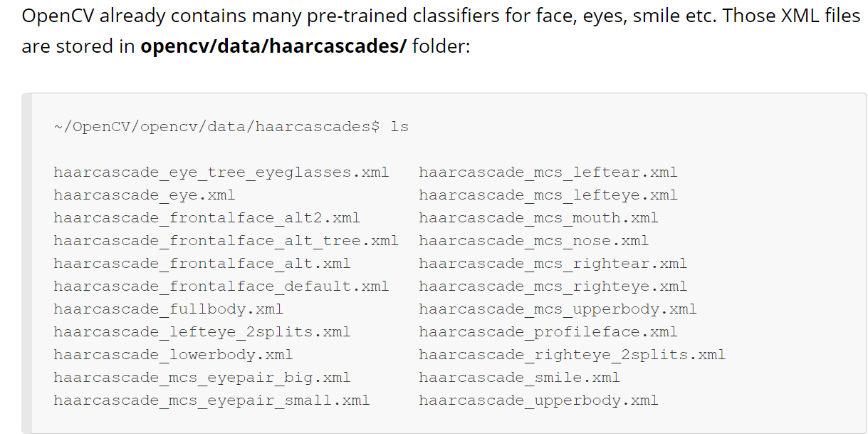
OpenCV’s pretrained classifiers

Slide 20
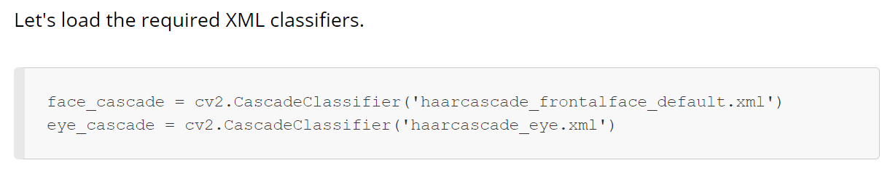
OpenCV’s face detection

Slide 21
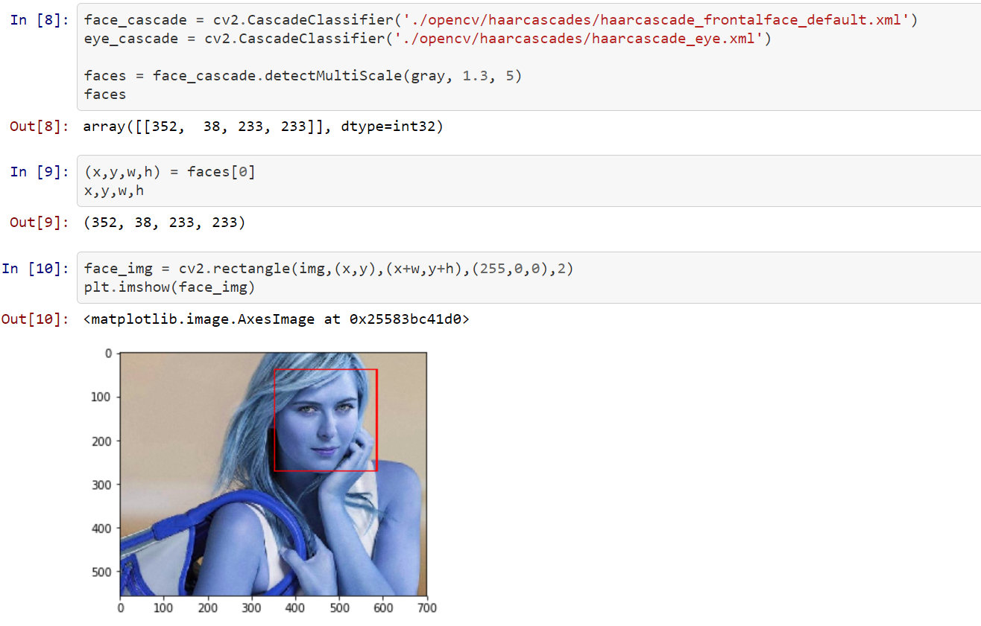
Face detection Code

Slide 22
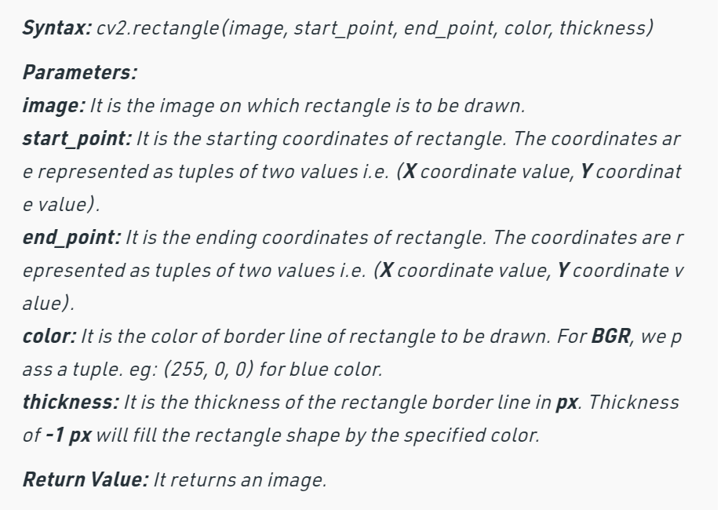
Cv2.rectangle()

Slide 23
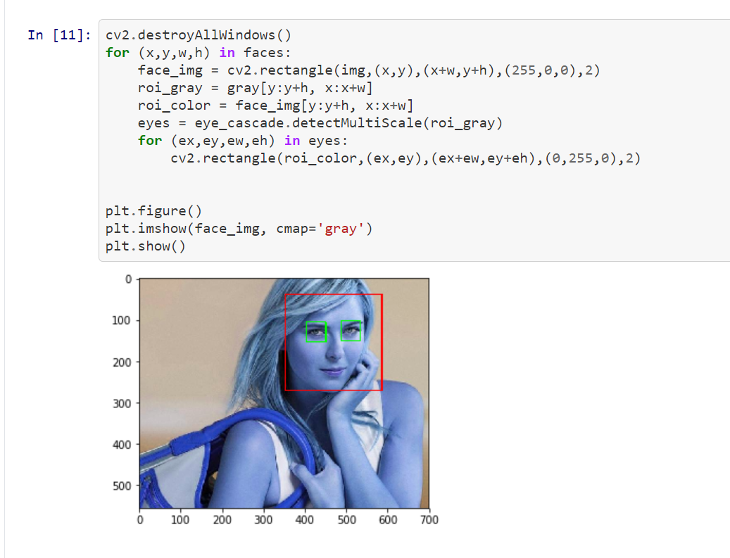
Face detection code

Slide 24
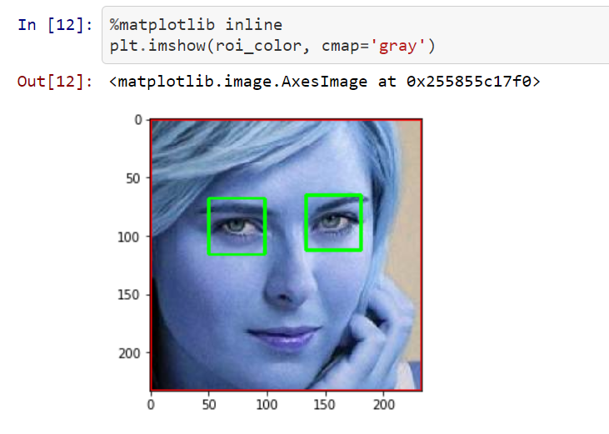
Crop the facial region of the image

Slide 25
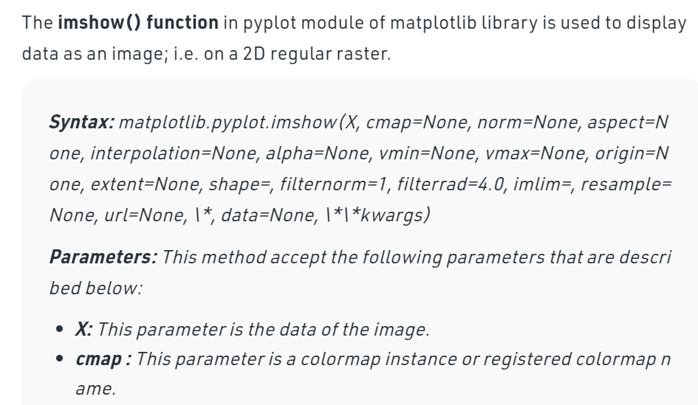
plt.imshow()

Slide 26
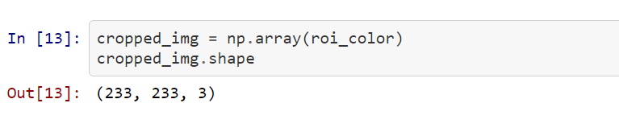
Cropped image

Slide 27
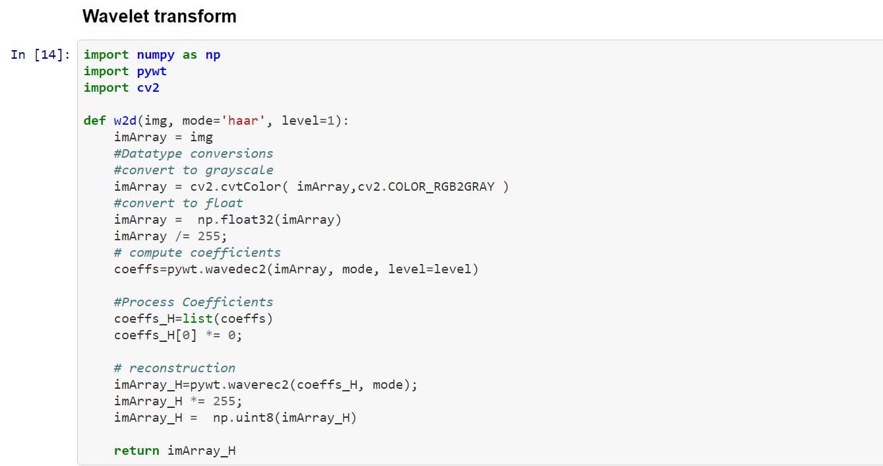
Wavelet transform
In a wavelet transformed image ,you can see edges clearly and that can give us clues on various facial features such as eyes,nose,lips etc.

Slide 28
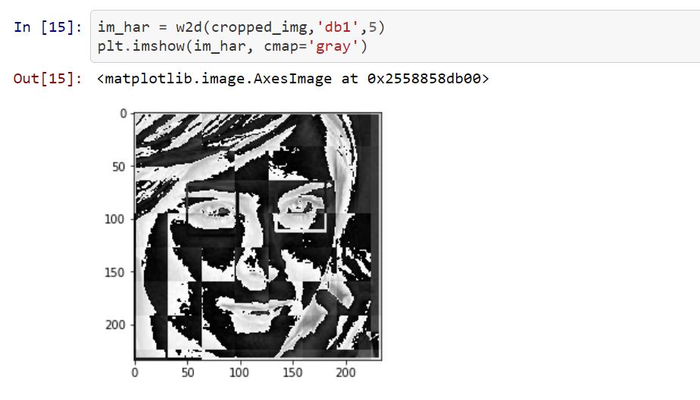
Wavelet transform

Slide 29
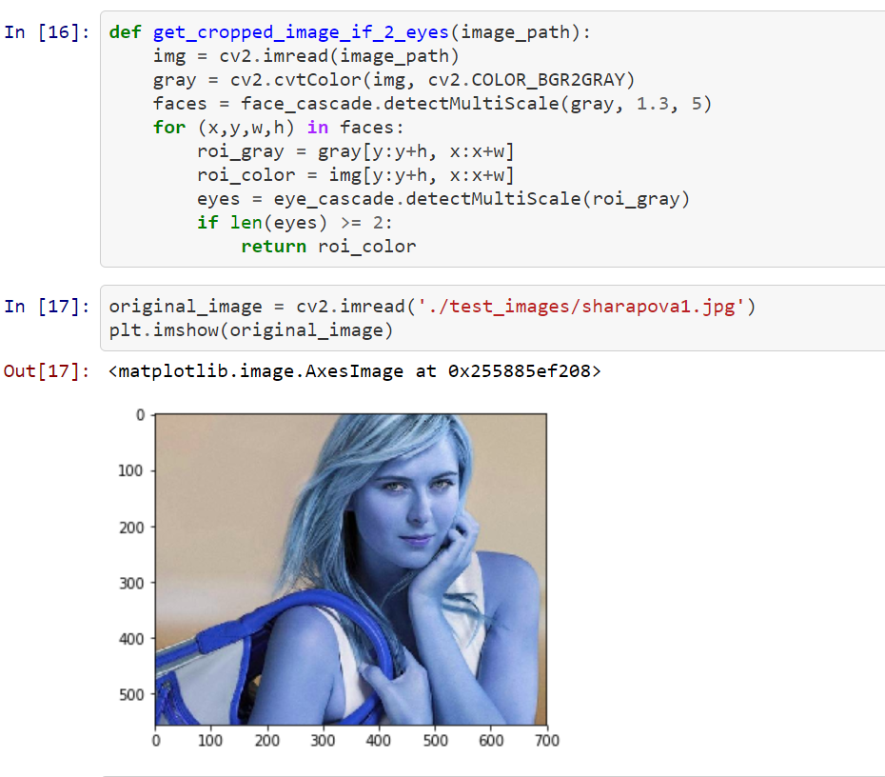
Load image,detect face .If eyes >=2 then save and crop the face region

Slide 30
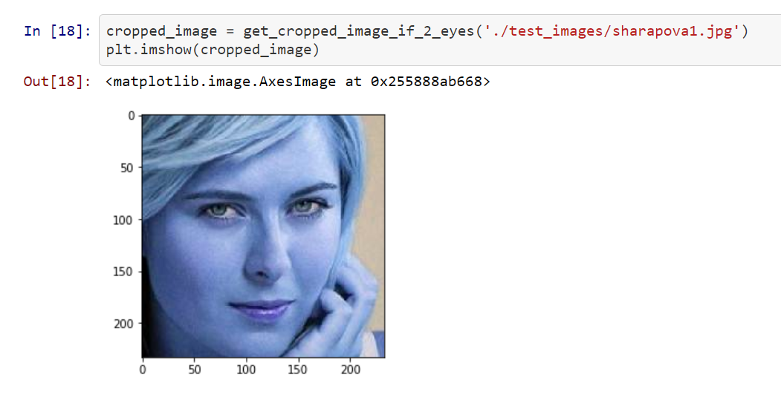
Function call

Slide 31
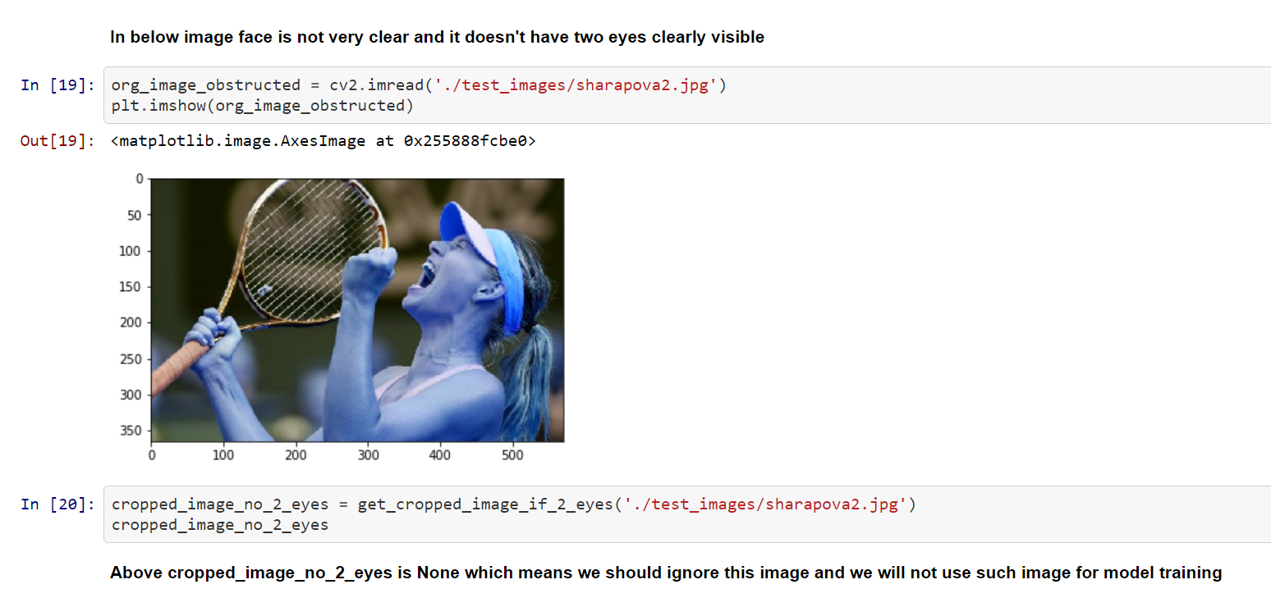
Function call

Slide 32
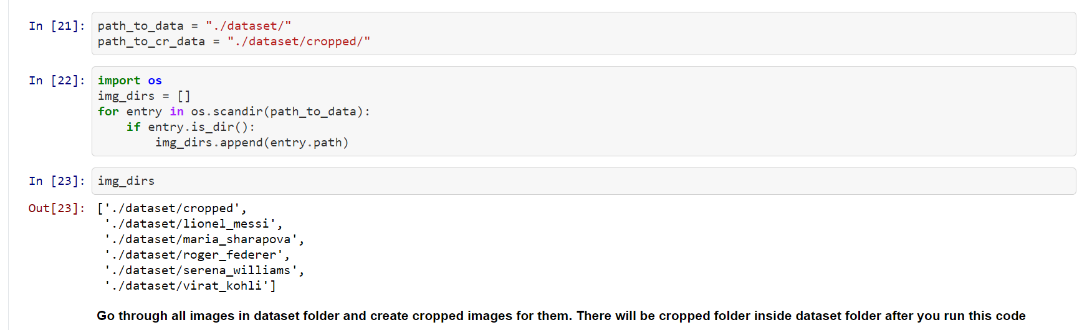
Cropped image folder

Slide 33
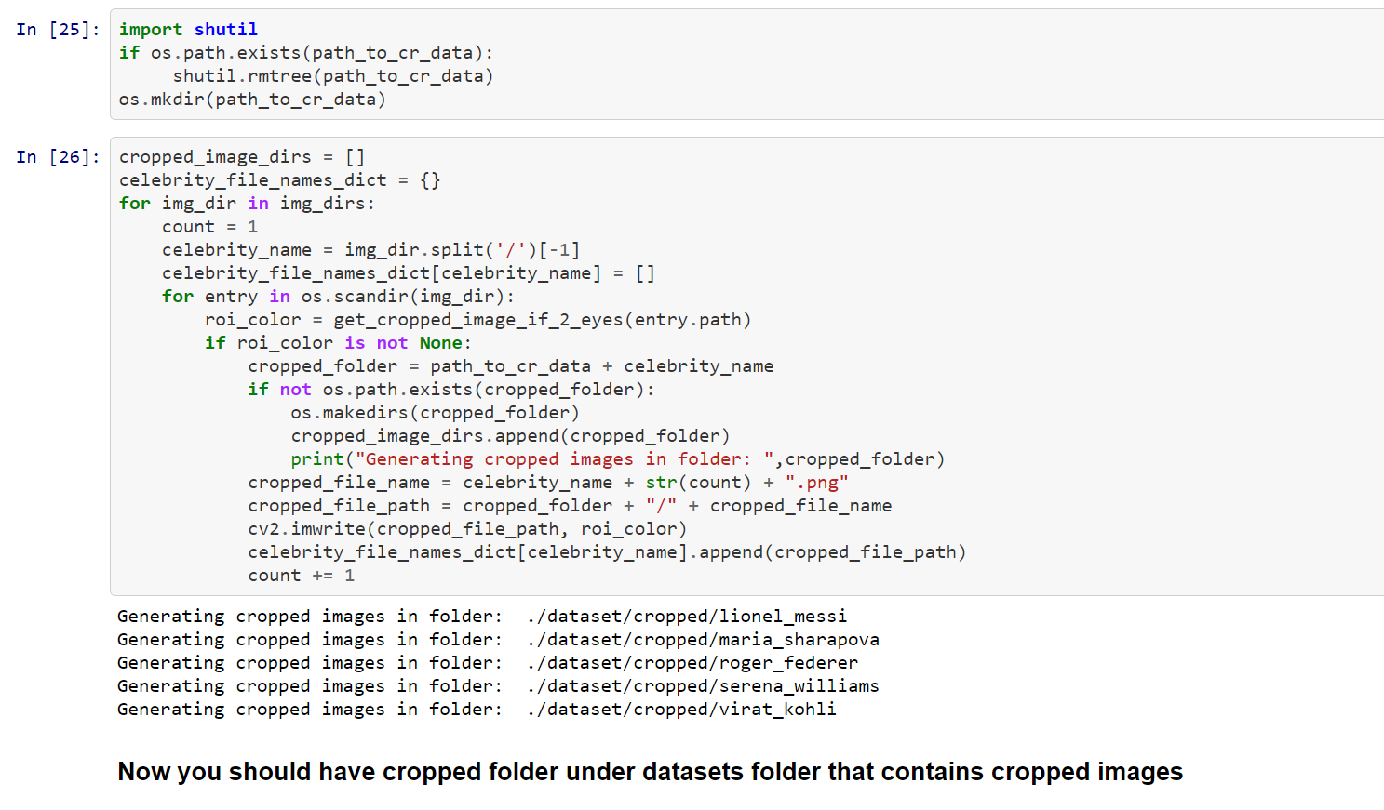
Images in cropped folder

Slide 34
Manual data cleaning
If you find any unwanted picture ,you can manually delete it.

Slide 35
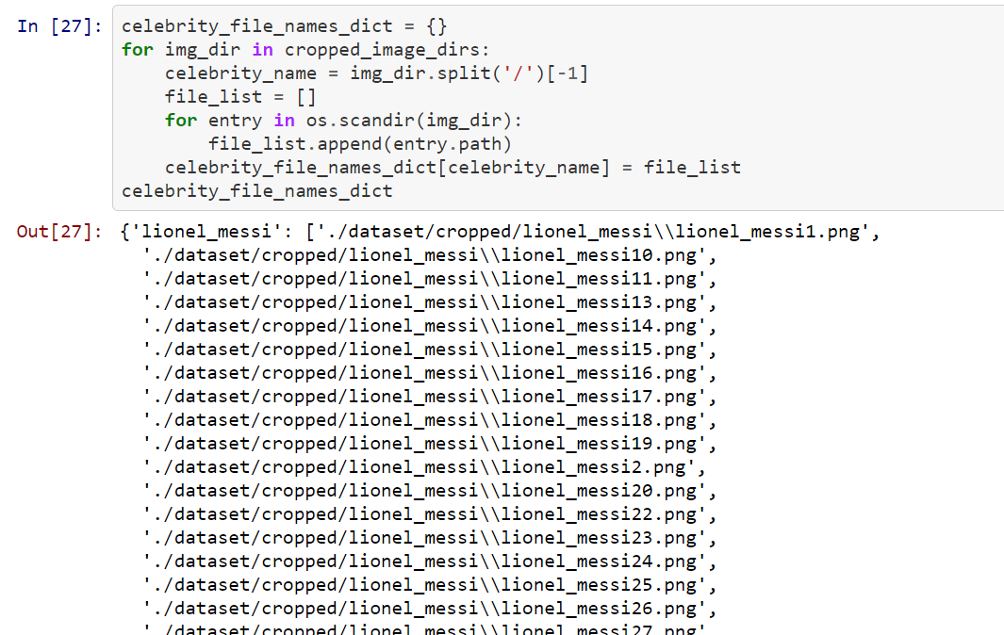
Create a dictionary for celeb

Slide 36
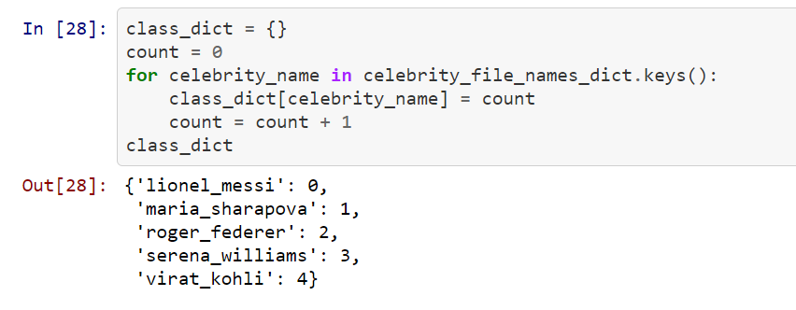
Create a dictionary

Slide 37
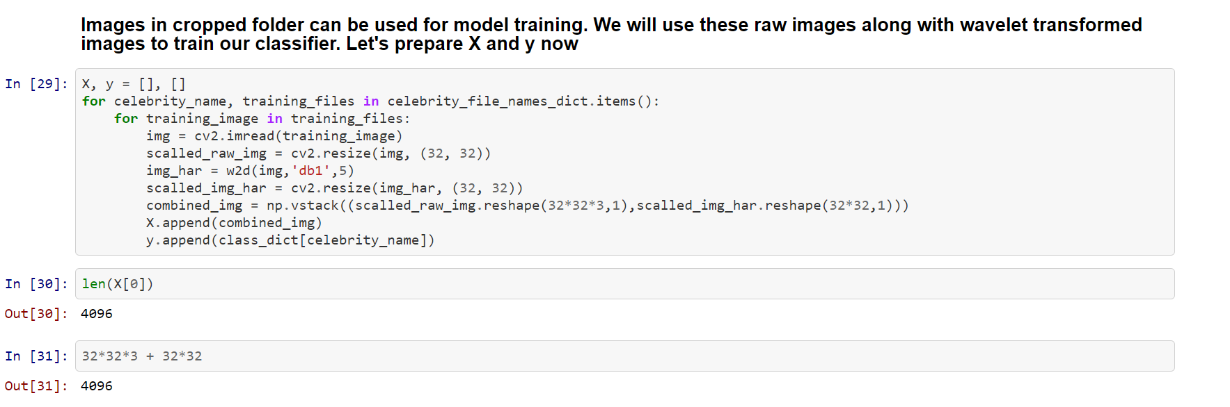
Prepare X and Y

Slide 38
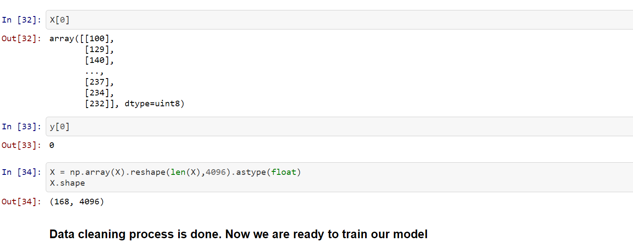
Prepare X and Y

Slide 39
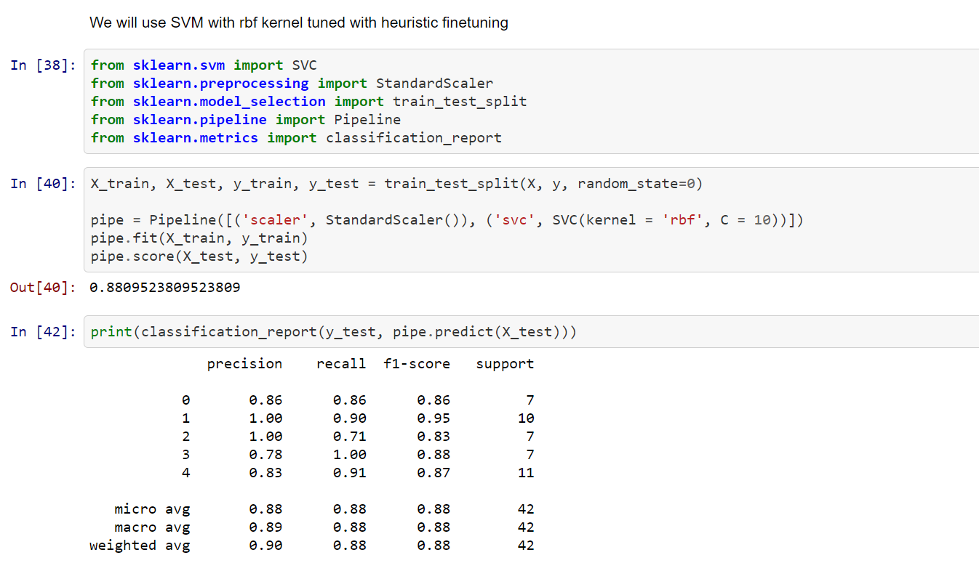
Model training

Slide 40
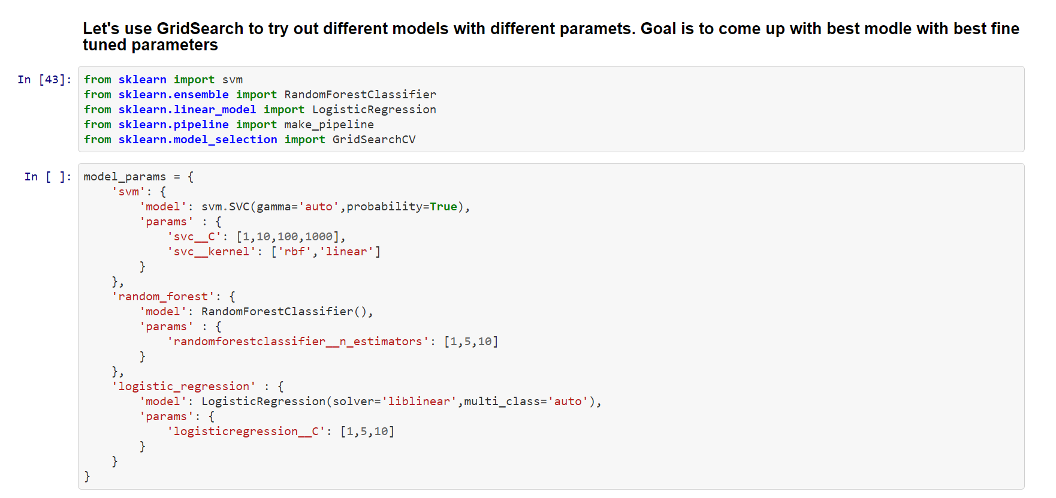
Gridsearch for best model

Slide 41
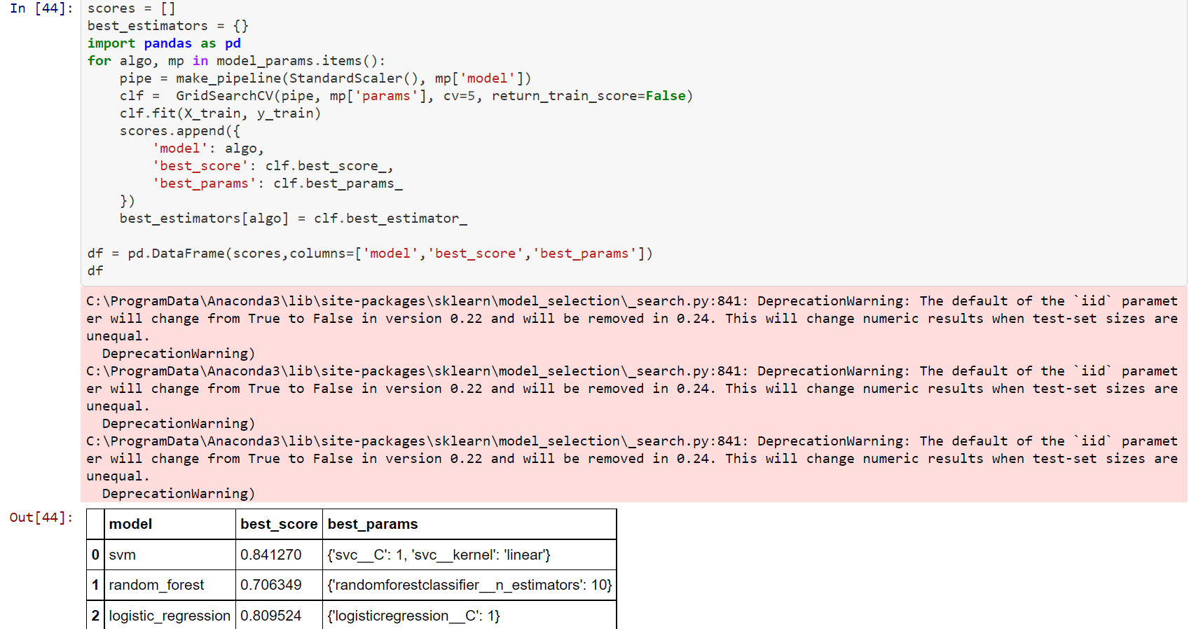
GridSearch

Slide 42
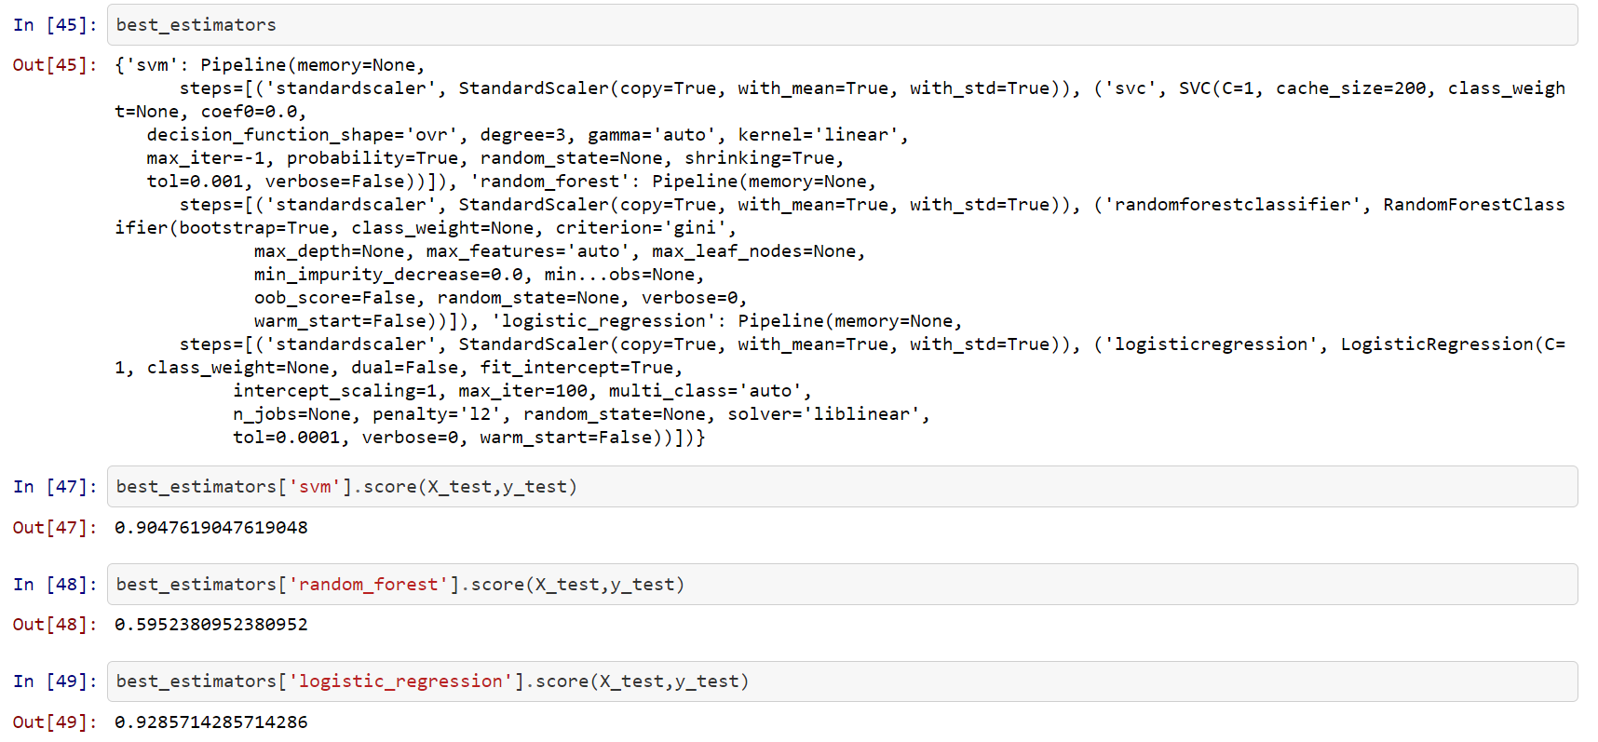
Best_estimators

Slide 43
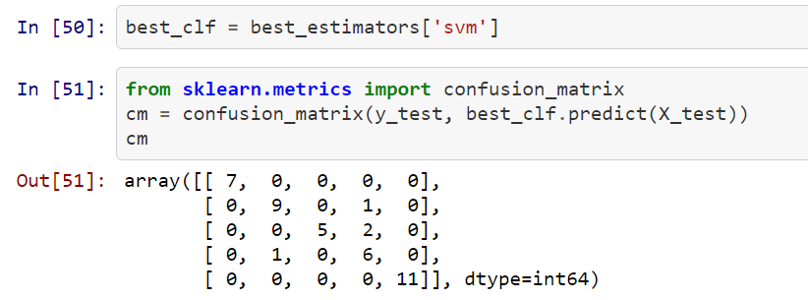
Confusion matrix

Slide 44
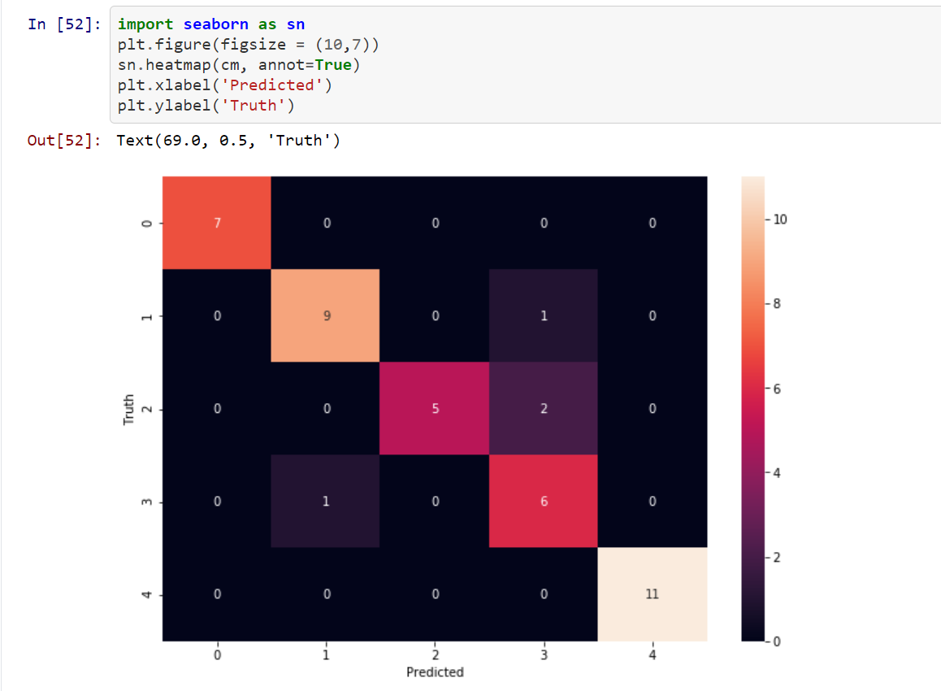
Confusion matrix

Slide 45
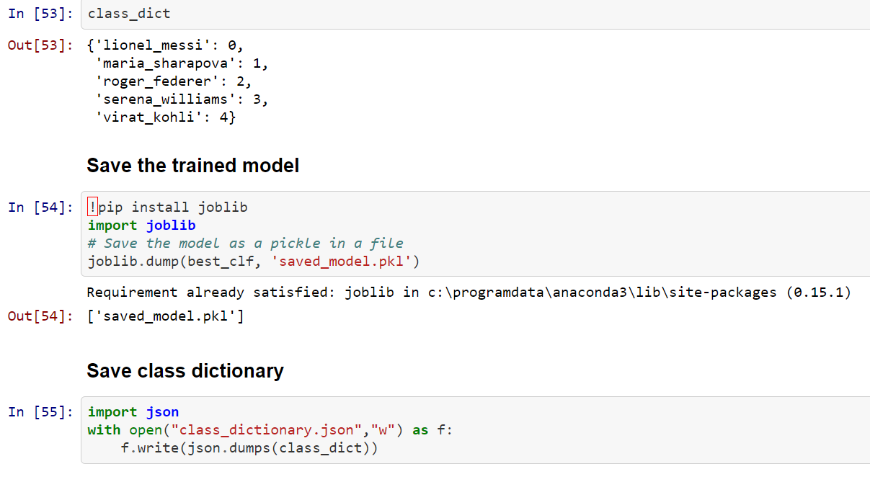
Save the model

